Slide 1

Game Development Process
Lyndon Herschell

Slide 2


Development Process
Ideation
Pre-production
Production
Post-production

Slide 3
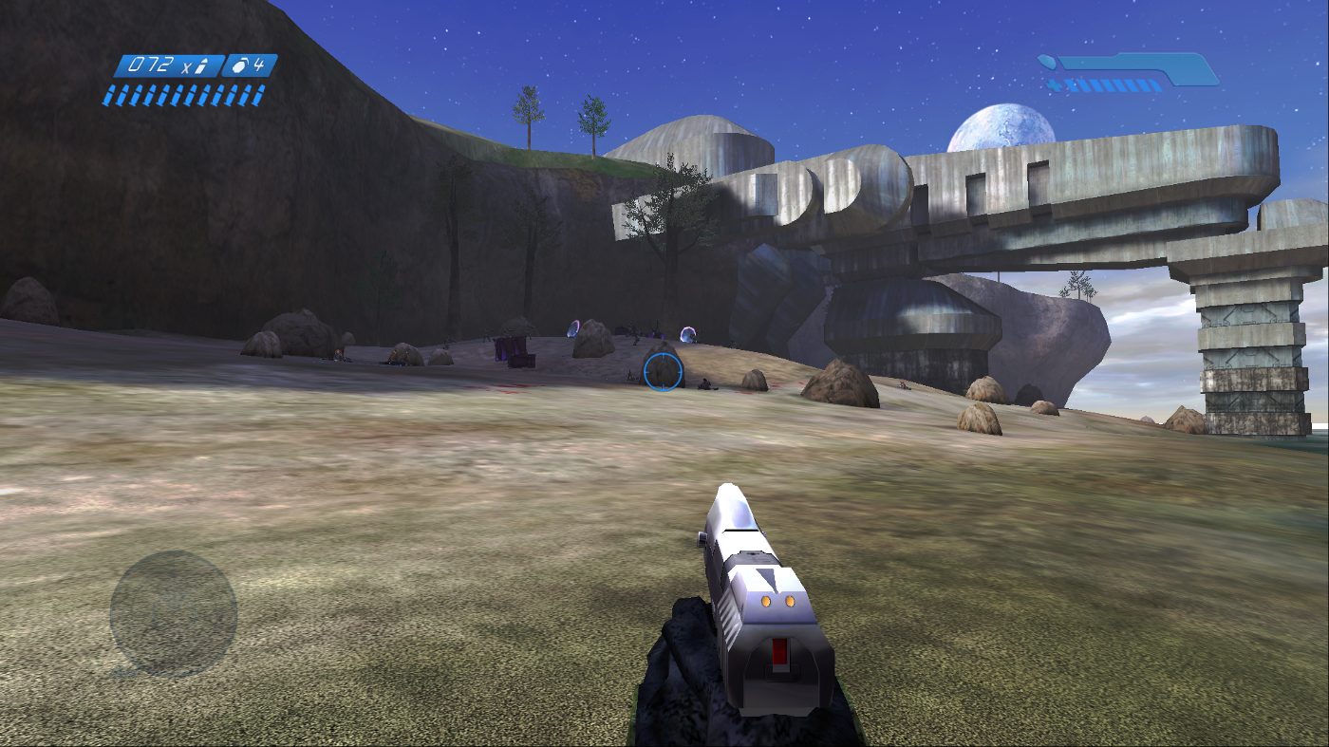
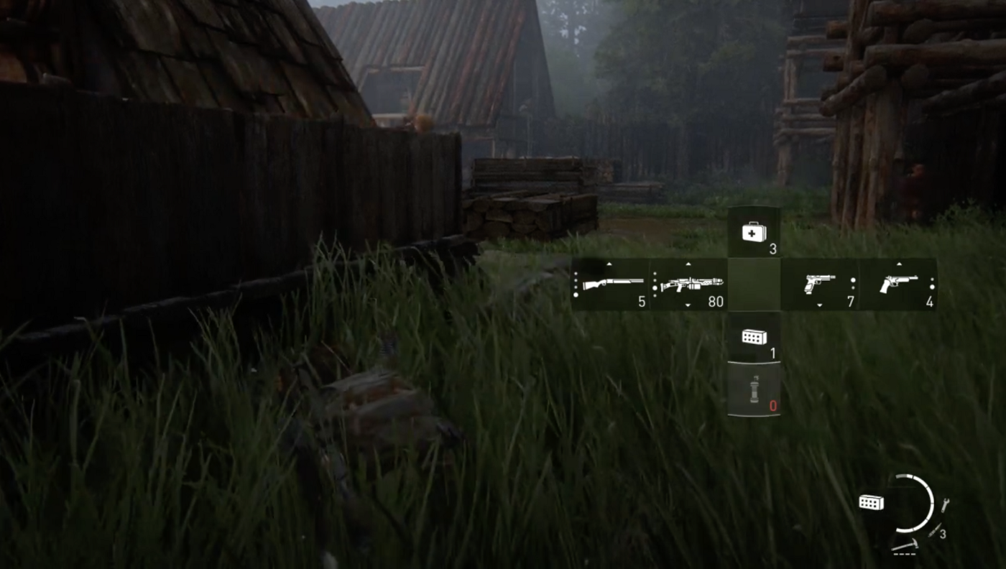
Design
Halo: Combat Evolved (2001)
The Last of Us: Part II (2019)

Slide 4
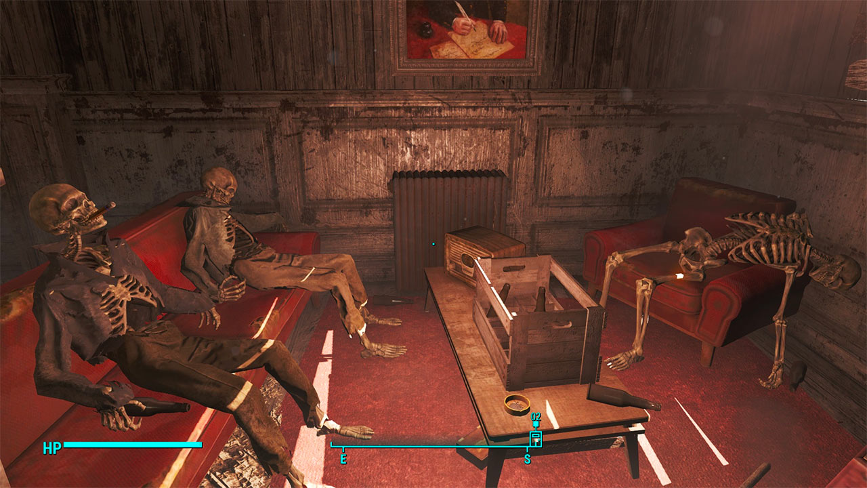
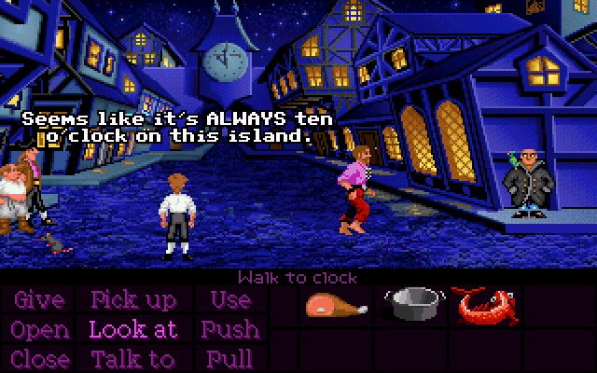
Storytelling
Visual (Implicit)
Direct (Explicit)
Fallout 4 (2015)
The Secret of Monkey Island (1990)

Slide 5
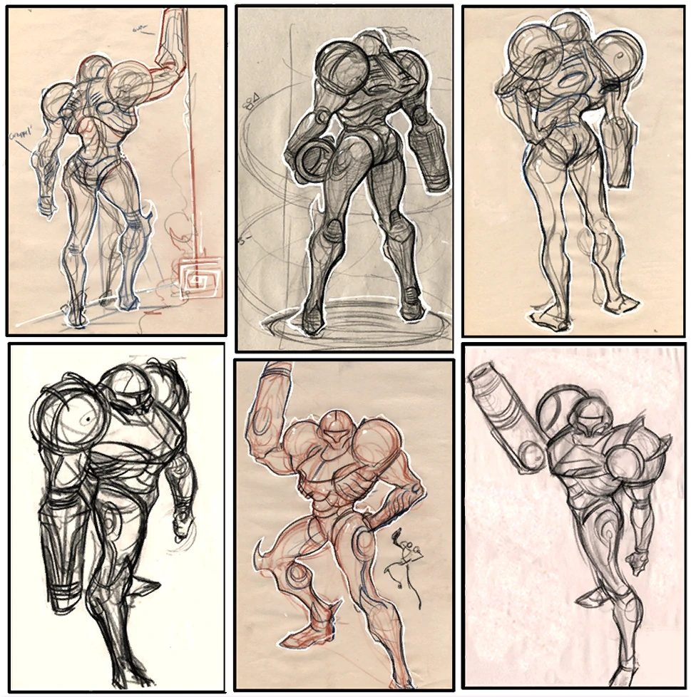
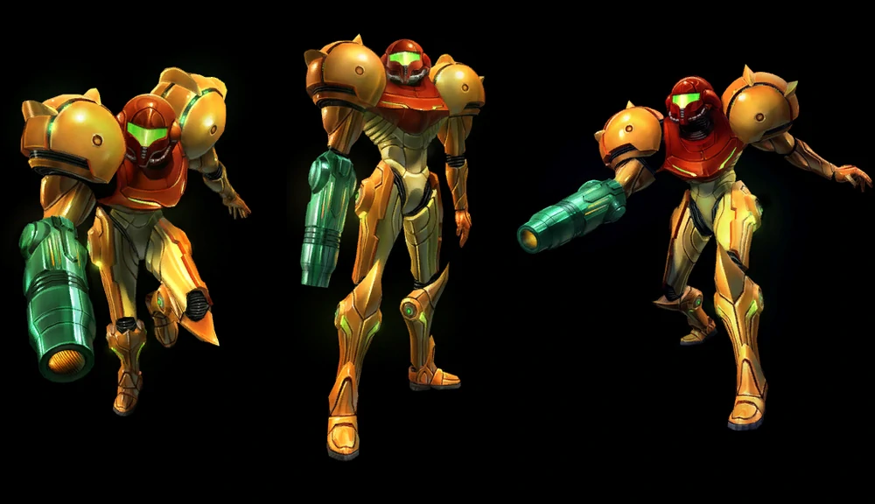
Artwork
Finalized Design
Concept Art
Metroid Prime (2002)

Slide 6
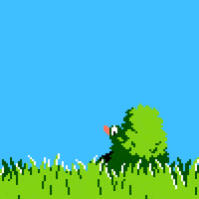

Animation
Duck Hunt (1984)
What The Golf? (2019)

Slide 7
Conclusion

Slide 8
Cites
G., Andrew. “The Making of Halo: How Combat Evolved from Blam!- Part 1.” Medium, Medium, 3 Feb. 2020, https://medium.com/@Oozer3993/the-making-of-halo-how-combat-evolved-from-blam-part-1-f6b58fcc4ade.
Jones, Simon K. “3 Approaches to Storytelling in Games.” Medium, Medium, 2 Sept. 2021, https://simonkjones.medium.com/3-approaches-to-storytelling-in-games-4e62de86ef30.
Meireles, Maria. “Designer Playing Games: The Last of US II.” Medium, UX Collective, 25 Dec. 2021, https://uxdesign.cc/uxd-playing-games-the-last-of-us-ii-7e93aecd2b3d.
Nintendo, "Duck Hunt." 1984.
Nintendo, "Metroid Prime." 2002.
Schardon, Lindsay. “What Is Game Design? A Guide for Making Video Games.” GameDev Academy, 14 Jan. 2023, https://gamedevacademy.org/what-is-game-design/.
Stefyn, Nadia. “How Video Games Are Made: The Game Development Process: CG Spectrum.” How Video Games Are Made | The Game Development Process | CG Spectrum, CG Spectrum, 21 Dec. 2022, https://www.cgspectrum.com/blog/game-development-process.
Triband, "What The Golf?" 2019.
Tyler, Dustin, and About Dustin TylerInitially focused on web dev. “What's the Difference between Animation and Video Game Design?” Video Game Design and Development, 12 Jan. 2023, https://www.gamedesigning.org/animation/animation-vs-video-game-design/.
“Visual Storytelling in Gaming: Video Game Stories: Gaming Debugged.” Gaming Debugged | Gaming Site Covering Xbox, Indies, News, Features and Gaming Tech, 13 Feb. 2023, https://www.gamingdebugged.com/2017/09/27/visual-storytelling-gaming/.

